Slide 1




Presented by :
Amr Ahmed, U20103240
El Mahdi Darouich, U20105997
Hamza Luai Ahmed, U22105870
Ali Adil Mashkoor, U21102681
Omar Ahmad Ateya, U21106598
Mahaz Ishtiaq khan, U22200217
Karam Mubadda Saleh, U22201141
> Under the Supervision of Dr. Manar <

Slide 2


Our Company
Syntax Solutions delivers smart software solutions that simplify property acquisition and management. We focus on efficiency, security, and user-friendly designs to help clients streamline their operations and transactions with ease.
Presented by :
Amr Ahmed, U20103240
El Mahdi Darouich, U20105997
Hamza Luai Ahmed, U22105870
Ali Adil Mashkoor, U21102681
Omar Ahmad Ateya, U21106598
Mahaz Ishtiaq khan, U22200217
Karam Mubadda Saleh, U22201141
> Under the Supervision of Dr. Manar <

Slide 3

Our Company
Introduction
Introducing LandMark
the innovative property acquisition app by Syntax Solutions. LandMark simplifies the process of buying, selling, and managing real estate through a seamless, user-friendly platform. With features like Bidding,Uploding properties, Investments, and real-time transaction tracking, LandMark ensures a smooth experience for both buyers and landlords. Our app makes real estate transactions efficient and transparent, all from the convenience of your device.
Syntax Solutions delivers smart software solutions that simplify property acquisition and management. We focus on efficiency, security, and user-friendly designs to help clients streamline their operations and transactions with ease.
Presented by :
Amr Ahmed, U20103240
El Mahdi Darouich, U20105997
Hamza Luai Ahmed, U22105870
Ali Adil Mashkoor, U21102681
Omar Ahmad Ateya, U21106598
Mahaz Ishtiaq khan, U22200217
Karam Mubadda Saleh, U22201141
> Under the Supervision of Dr. Manar <

Slide 4
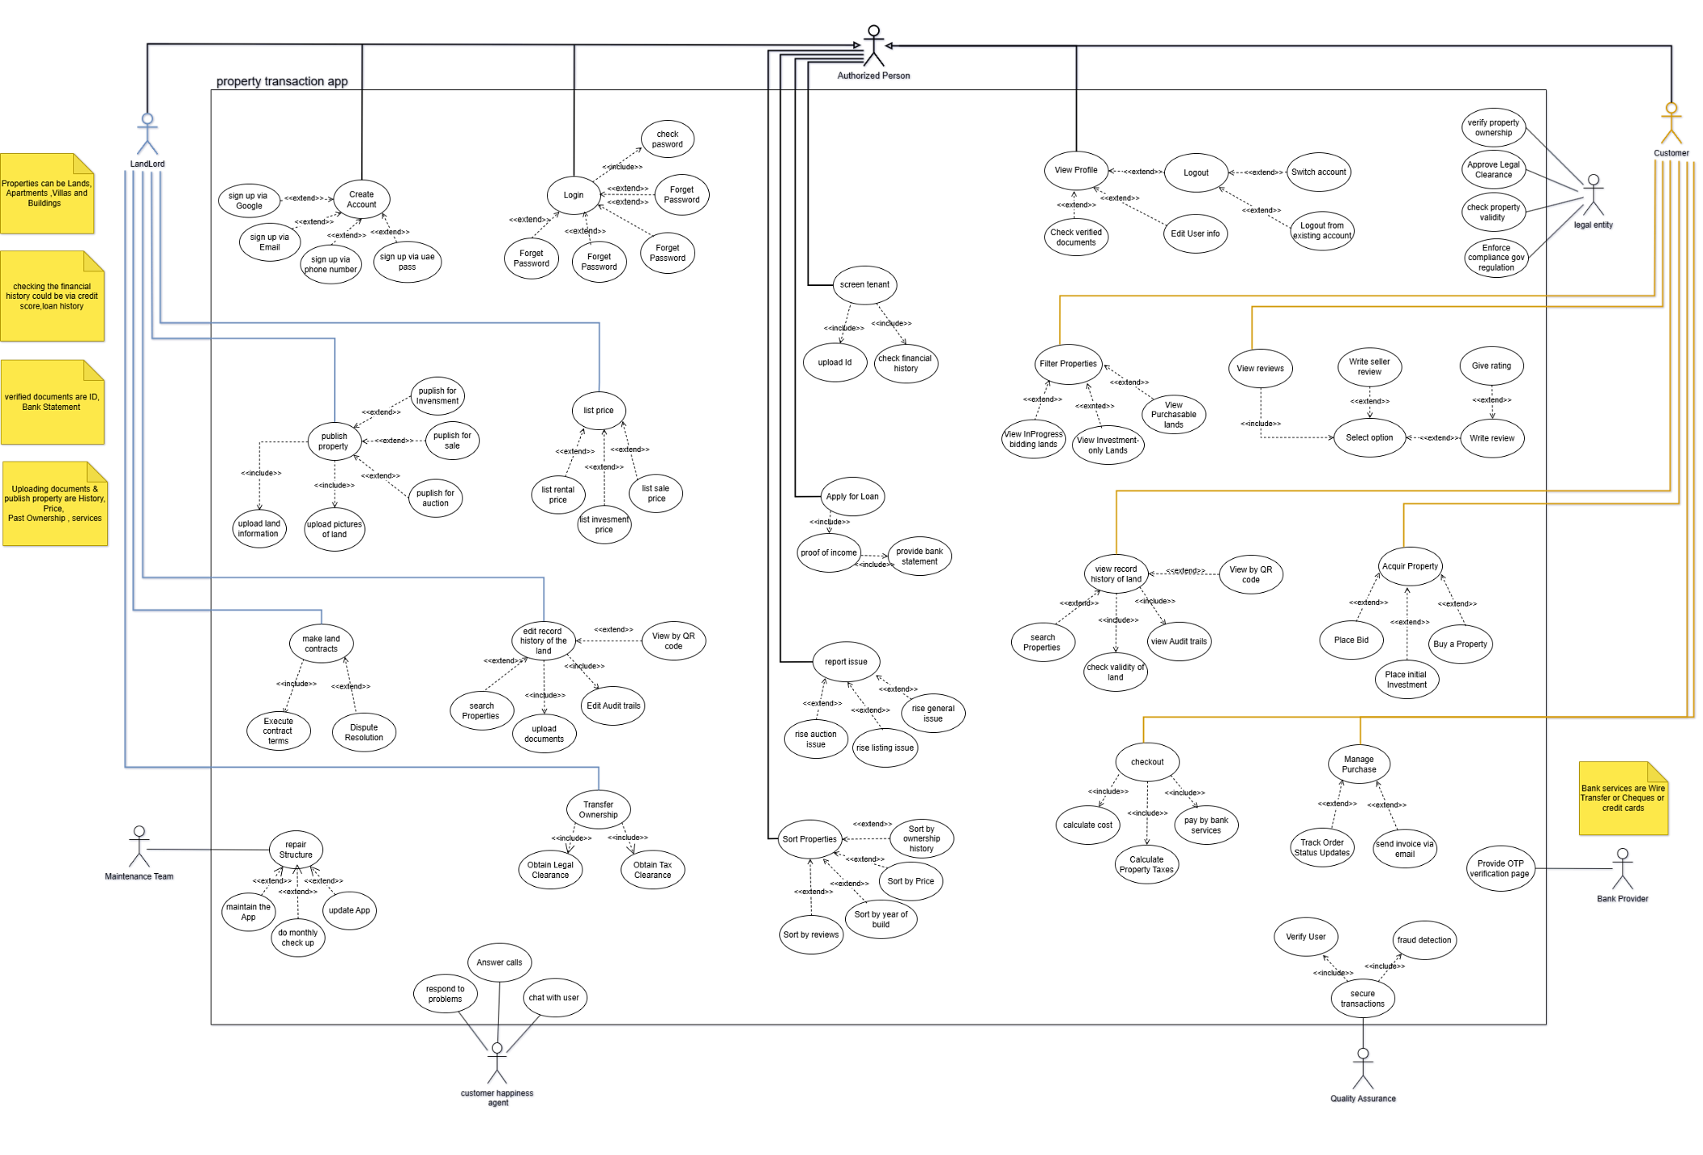
Introduction
Our Company
Introducing LandMark
the innovative property acquisition app by Syntax Solutions. LandMark simplifies the process of buying, selling, and managing real estate through a seamless, user-friendly platform. With features like Bidding,Uploding properties, Investments, and real-time transaction tracking, LandMark ensures a smooth experience for both buyers and landlords. Our app makes real estate transactions efficient and transparent, all from the convenience of your device.
Syntax Solutions delivers smart software solutions that simplify property acquisition and management. We focus on efficiency, security, and user-friendly designs to help clients streamline their operations and transactions with ease.
Use-Case

Slide 5
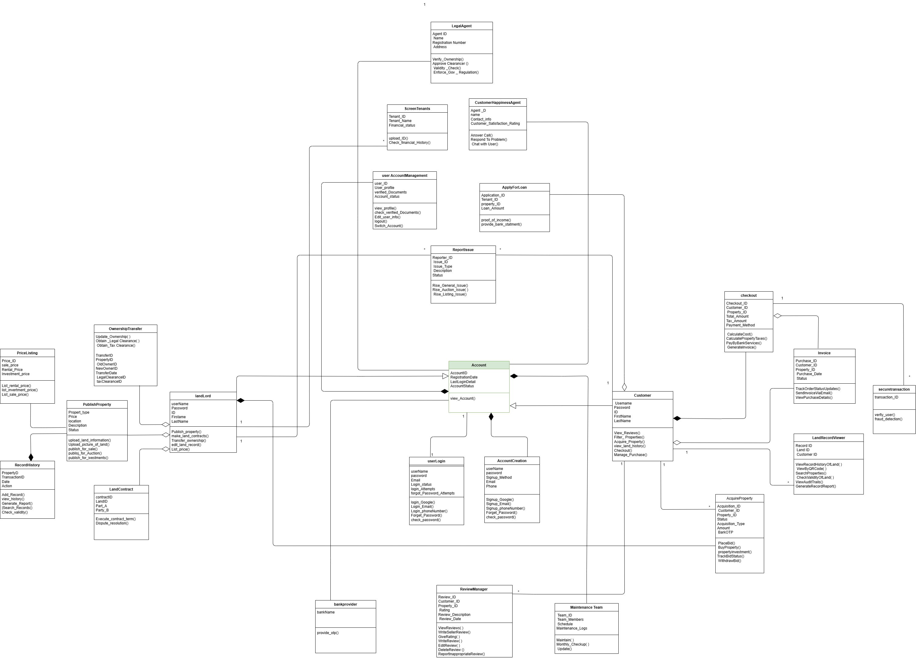
Introduction
Introducing LandMark
the innovative property acquisition app by Syntax Solutions. LandMark simplifies the process of buying, selling, and managing real estate through a seamless, user-friendly platform. With features like Bidding,Uploding properties, Investments, and real-time transaction tracking, LandMark ensures a smooth experience for both buyers and landlords. Our app makes real estate transactions efficient and transparent, all from the convenience of your device.
Sequence Diagram
Use-Case

Slide 6

Introduction
Introducing LandMark
the innovative property acquisition app by Syntax Solutions. LandMark simplifies the process of buying, selling, and managing real estate through a seamless, user-friendly platform. With features like Bidding,Uploding properties, Investments, and real-time transaction tracking, LandMark ensures a smooth experience for both buyers and landlords. Our app makes real estate transactions efficient and transparent, all from the convenience of your device.
Sequence Diagram
Use-Case

Slide 7
Introduction
Introducing LandMark
the innovative property acquisition app by Syntax Solutions. LandMark simplifies the process of buying, selling, and managing real estate through a seamless, user-friendly platform. With features like Bidding,Uploding properties, Investments, and real-time transaction tracking, LandMark ensures a smooth experience for both buyers and landlords. Our app makes real estate transactions efficient and transparent, all from the convenience of your device.
Sequence Diagram
Use-Case

Slide 8
Introduction
Introducing LandMark
the innovative property acquisition app by Syntax Solutions. LandMark simplifies the process of buying, selling, and managing real estate through a seamless, user-friendly platform. With features like Bidding,Uploding properties, Investments, and real-time transaction tracking, LandMark ensures a smooth experience for both buyers and landlords. Our app makes real estate transactions efficient and transparent, all from the convenience of your device.
Class Diagram
Use-Case

Slide 9
Class Diagram (Customer)
Class Diagram
Use-Case

Slide 10
Class Diagram (LandLord)
Class Diagram (Customer)
Class Diagram

Slide 11
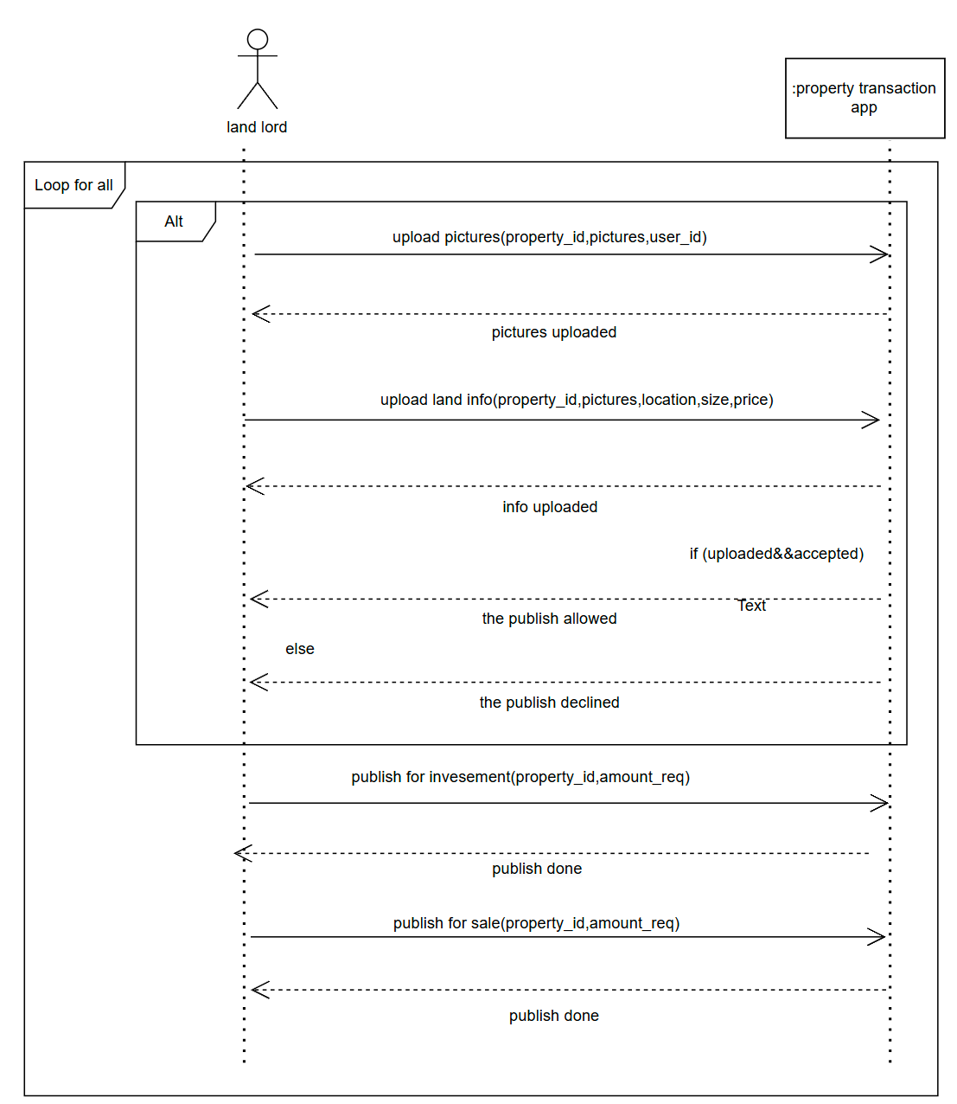
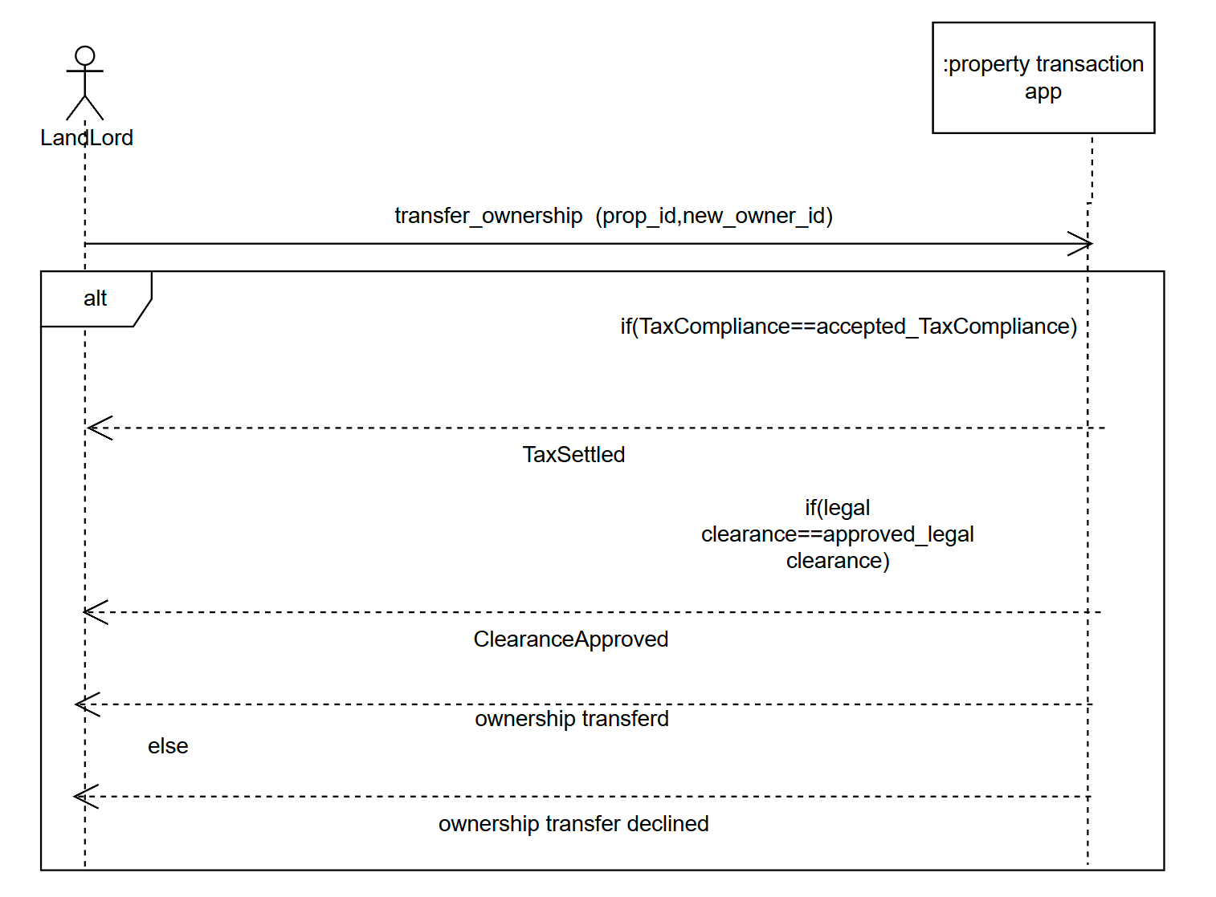
Sequence Diagrams
Publishing Property
Transfer Ownership
Class Diagram (LandLord)
Class Diagram (Customer)

Slide 12
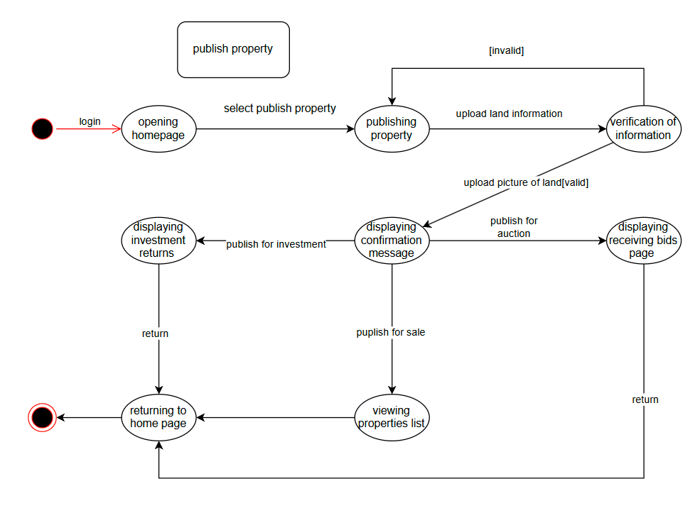
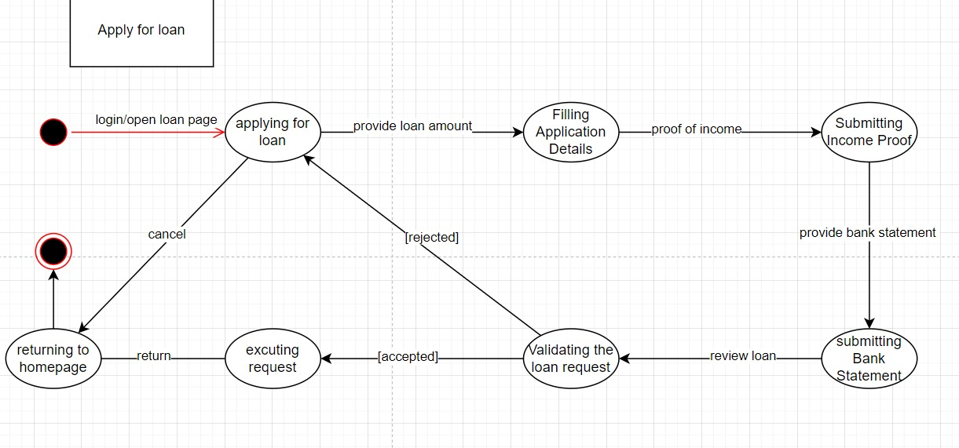
Sequence Diagrams
State Diagrams
Publishing Property
Transfer Ownership
The state chart models the property publishing process in the application
The state chart models the System Loan process in the application
Class Diagram (LandLord)

Slide 13
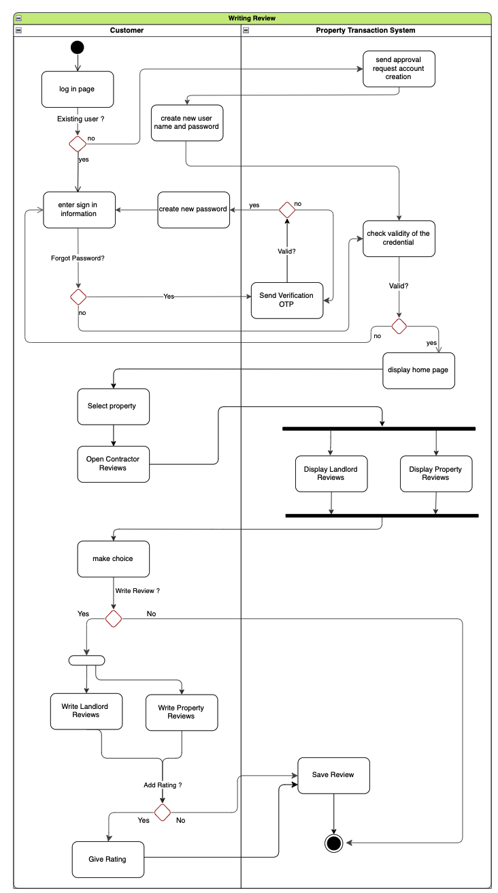
Sequence Diagrams
State Diagrams
Publishing Property
Transfer Ownership
The state chart models the property publishing process in the application
The state chart models the System Loan process in the application
Activity Diagrams
This model demonstrates the flow of process when writing a review

Slide 14
State Diagrams
The state chart models the property publishing process in the application
The state chart models the System Loan process in the application
Activity Diagrams (Login Process)
Activity Diagrams
This model demonstrates the flow of process when writing a review

Slide 15
Activity Diagrams
Activity Diagram (Writing review)
Activity Diagrams (Login Process)
This model demonstrates the flow of process when writing a review

Slide 16

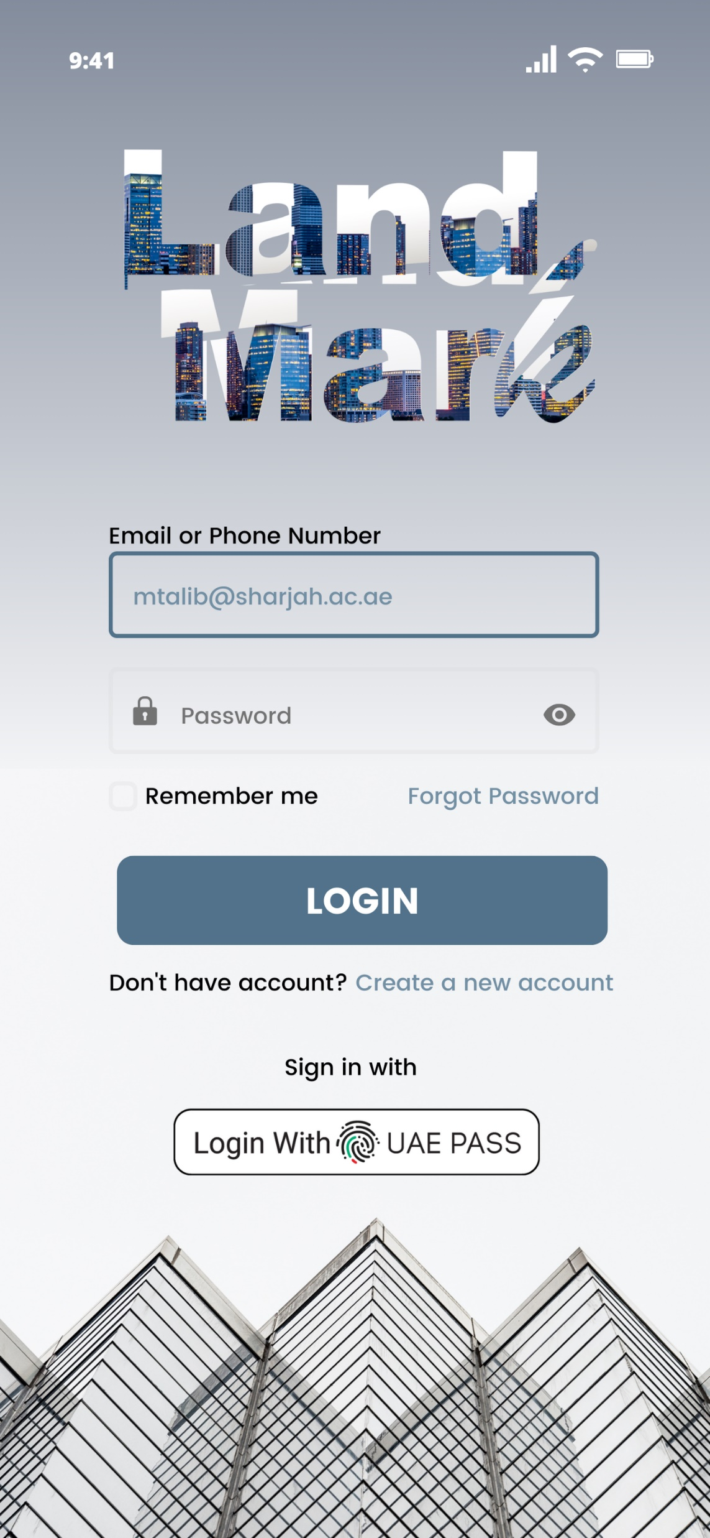
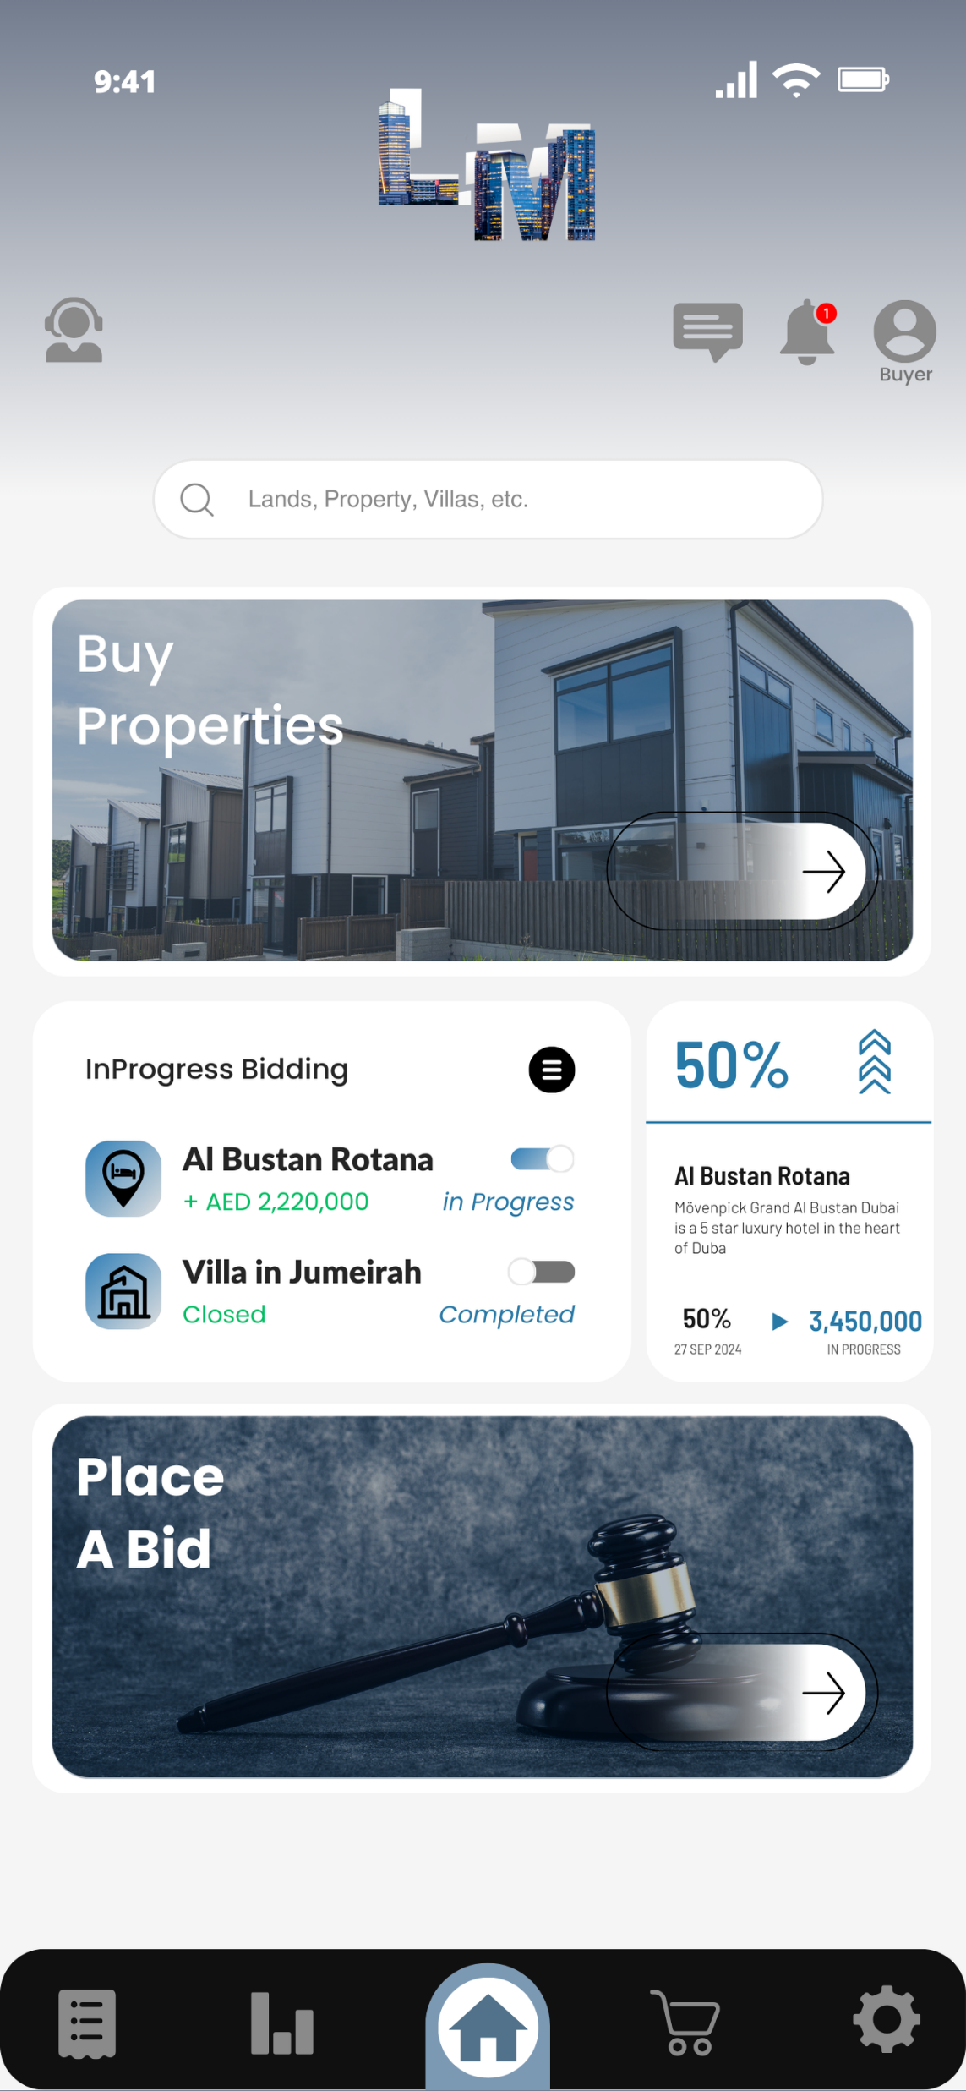
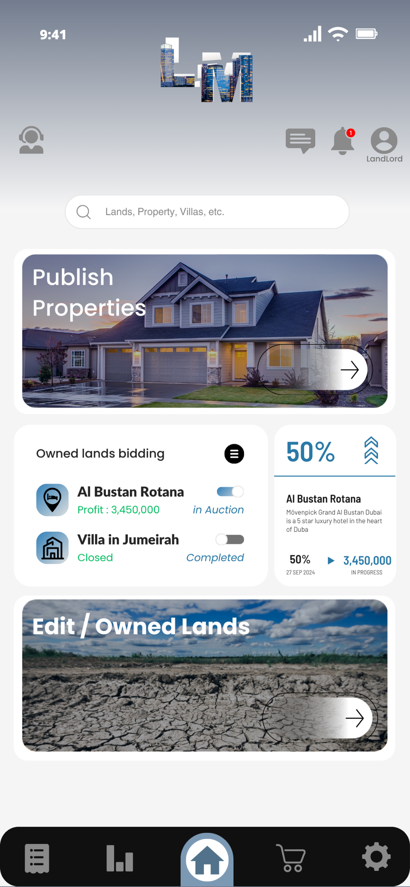
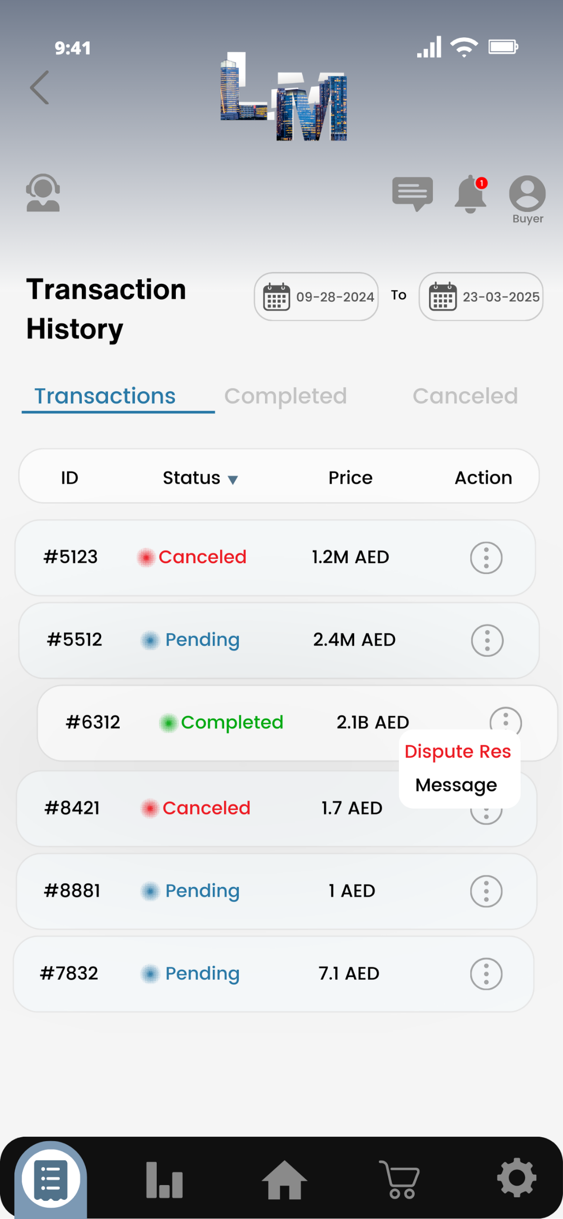
Activity Diagrams (Login Process)
UI (User-Interface)
Activity Diagram (Writing review)
Homepage (Buyer)
Homepage (Landlord)
Transaction
History
Login

Slide 17
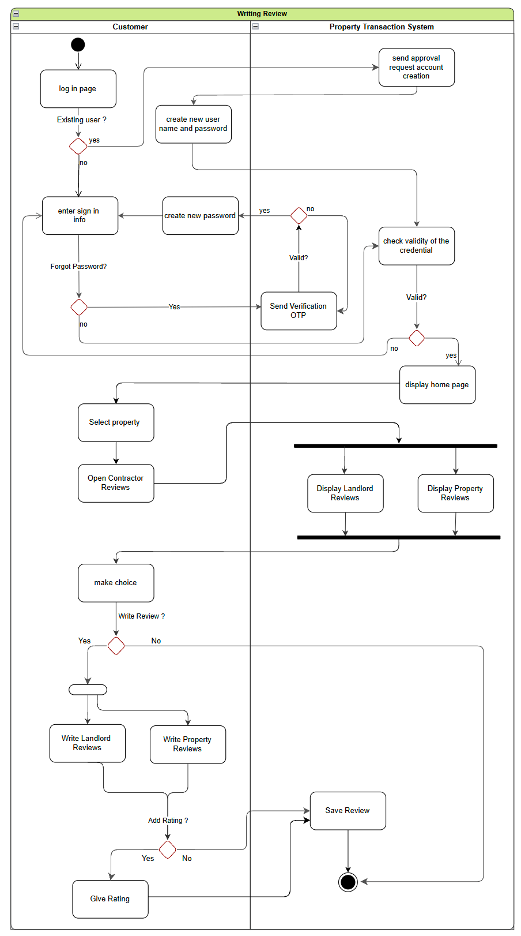
UI (User-Interface)
Activity Diagram (Writing review)
How much
I'm bidding
How much
He's Profiting
Homepage (Buyer)
Homepage (Landlord)
Transaction
History
Login

Slide 18
Conclusion
UI (User-Interface)
Activity Diagram (Writing review)
How much
I'm bidding
How much
He's Profiting
Homepage (Buyer)
Homepage (Landlord)
Transaction
History
Login
our property app simplifies buying, selling, and investing for everyone, featuring a variety of diagrams to highlight its functions. With easy ownership transfers, property publishing for landlords, and detailed land history viewing, users can confidently navigate the market with ease of use .The app also ensures secure transactions through blockchain technology, making it safe and reliable. Whether you’re a landlord managing properties or a buyer searching for your next home, our app enhance the process and makes real estate accessible for all

Slide 19
Conclusion
Activity Diagram (Writing review)
UI (User-Interface)
our property app simplifies buying, selling, and investing for everyone, featuring a variety of diagrams to highlight its functions. With easy ownership transfers, property publishing for landlords, and detailed land history viewing, users can confidently navigate the market with ease of use .The app also ensures secure transactions through blockchain technology, making it safe and reliable. Whether you’re a landlord managing properties or a buyer searching for your next home, our app enhance the process and makes real estate accessible for all
How much
I'm bidding
How much
He's Profiting
Homepage (Buyer)
Transaction
History
Homepage (Landlord)
Login

